Slide 1
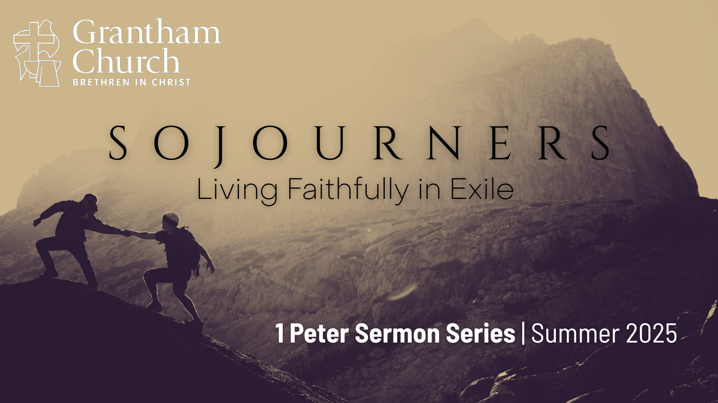
Notes:
Today we are continuing our journey through 1 Peter in our summer sermon series, Sojourners: Living Faithfully in Exile.
In 1 Peter 2:11-12, we read two key verses in Peter’s letter to churches scattered throughout Asia Minor… NEXT SLIDE]

Slide 2
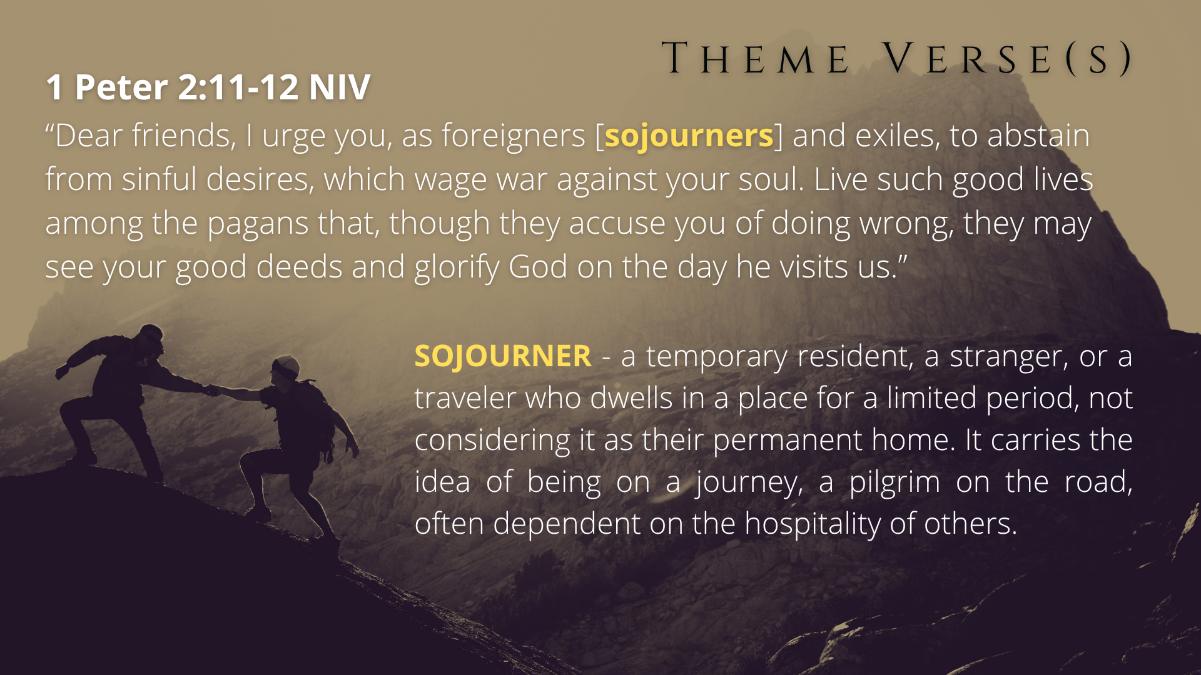
Notes:
He says, “Dear friends, I urge you, as foreigners [sojourners] and exiles, to abstain from sinful desires, which wage war against your soul. Live such good lives among the pagans that, though they accuse you of doing wrong, they may see your good deeds and glorify God on the day he visits us.” And so, we hear and need to pay attention to this language that’s used to describe followers of Jesus in the New Testament; we are strangers, foreigners, aliens, exiles, pilgrims, and sojourners in this world.
When Peter describes believers this way, he most certainly would have had in mind a major part of Israel’s story—a time of living and suffering in a land that wasn’t their home; a time that had a huge impact on their theology, their understanding of God, the reality of our spiritual struggle between good and evil, and how to navigate the idolatrous forces of the world as worshippers of the one true God. Peter would have had in mind what is known as the Babylonian Exile… [NEXT SLIDE]

Slide 3
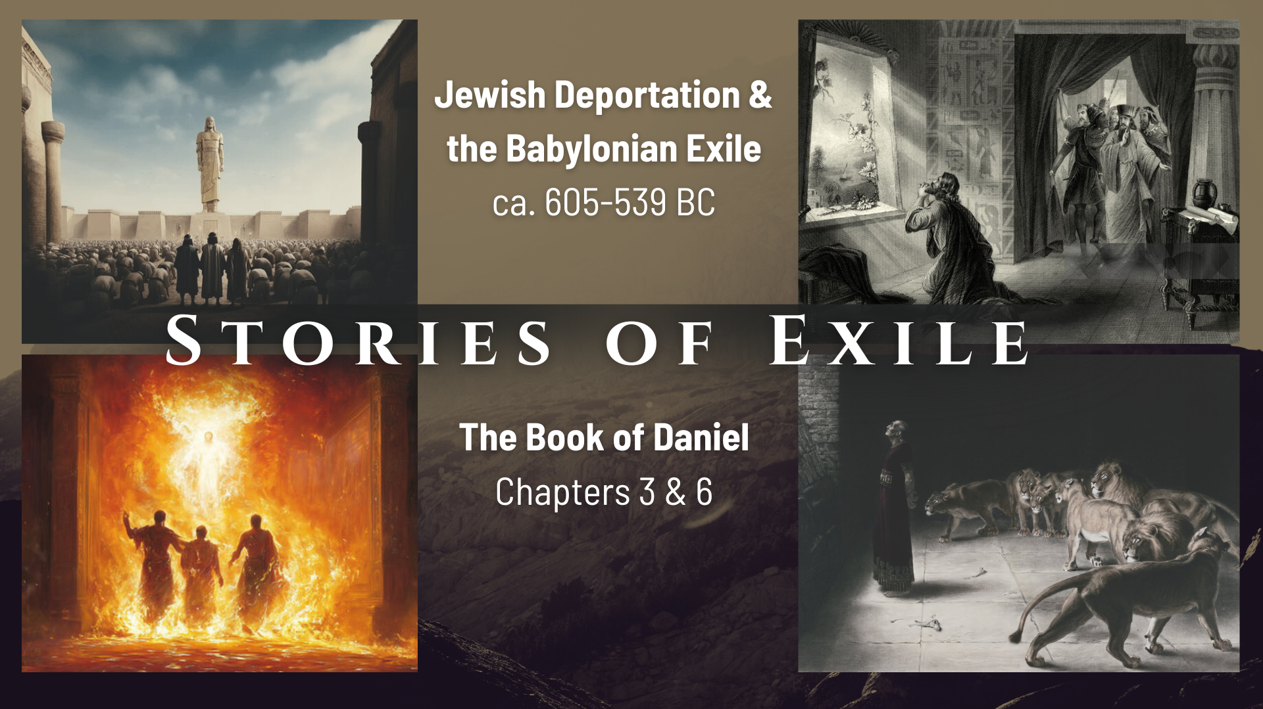
Notes:
It was the end of the 7th century BC when Babylon begins to lay siege to Jerusalem. The prophet Jeremiah had warned that this would happen if the people of the Kingdom of Judah did not repent of their idolatry, stop oppressing the poor, and promoting injustice. And since they didn’t repent, King Nebuchadnezzar’s army began a slow take over of the city of Jerusalem and started by deporting the strongest and the brightest men among the Jews back with them to live and serve in Babylon.
And in the book of Daniel, we’re told a few stories of the challenges these young men faced as they sought to be faithful to God among a people that spoke a different language, ate foods that weren’t kosher, and worshipped other gods. Many of you will recall the stories of Daniel, who wouldn’t stop praying to Yahweh, his God, and so he was thrown into the lion’s den, only to be delivered. And also, the story of Hananiah, Mishael, and Azariah (later given Babylonian names: Shadrach, Meshach, and Abednego). In Daniel 3, we read Shadrach, Meshach, and Abednego refused to bow down to the golden statue of Nebuchadnezzar and so they are thrown in the fiery furnace. Listen to the resolve and deep faith of these men as they faced the prospect of a terrible death… [NEXT SLIDE]

Slide 4
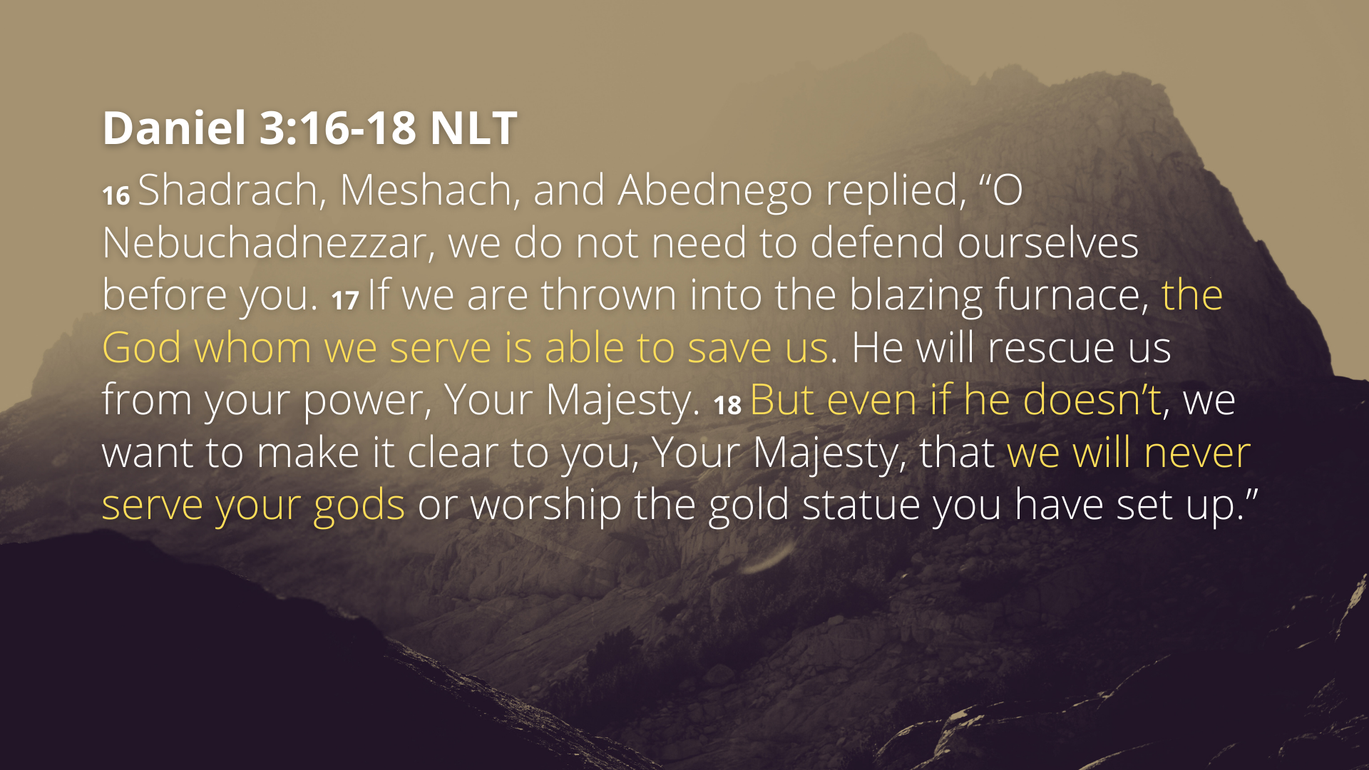
Notes:
[READ PASSAGE & COMMENT]
And so, when you read 1 Peter and we hear him encourage and give guidance on how to live on earth as strangers and sojourners, and how we ought to respond to hardship, trials, and suffering, remember that it’s stories like these that are in his cultural and religious memory. Peter would see himself and all Christians like these ancient exiles. These are the stories of our ancestors.
Therefore, before we move into the last section of Peter’s letter and hear him address our sufferings, may we recognize that we (as disciples of Jesus) are following in the footsteps of those who have gone before us. And like them, we too can be faithful in the fire. And if you’re taking notes, that is what I’ve entitled message 8 of 9… [NEXT SLIDE]

Slide 5
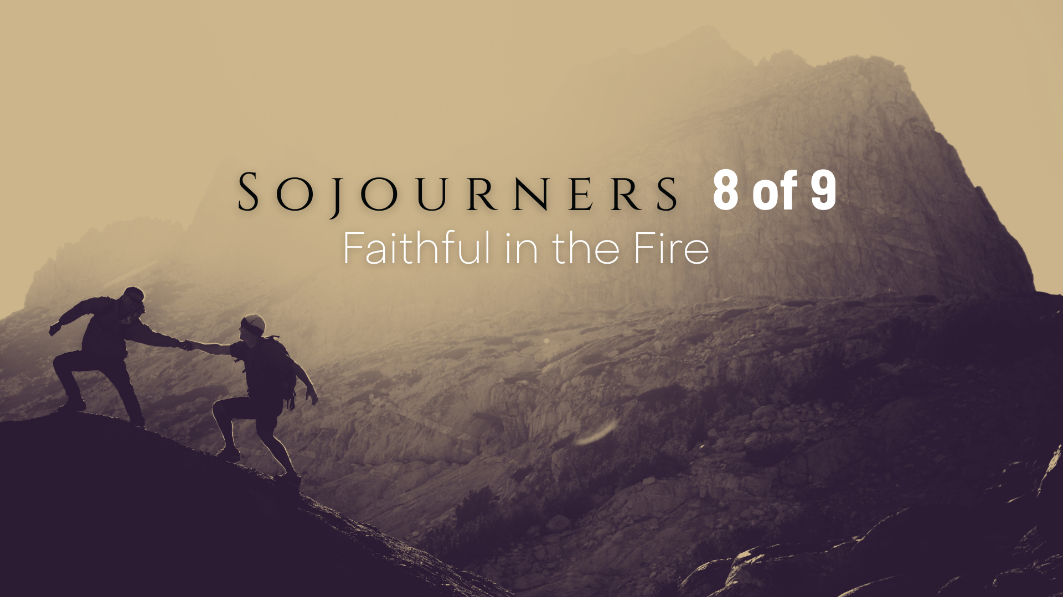
Notes:
Faithful in the Fire. [BRIEF PRAYER]
There are many kinds of suffering. If you live in this world long enough, suffering will come just by being alive. But let me ask you this: How have you suffered for Jesus? In service of Christ and because of your faith in God, what trials and tribulations have you endured? How has the world rejected you at some point and in some way because of your faith or witness?
[MY EXPERIENCES OF SUFFERING]
If I’m being honest, as a pastor, I’ve experienced more suffering through the church than the world
No one has ever hurt or harmed me physically; though I have felt anxiety and stress in my body; I’ve been physically sick from simply trying to faithfully lead in difficult times.
My suffering usually comes by carrying the burdens of dozens of people all at once. It can also look like mental and emotional anguish that’s been caused by a careless word, an anonymous note, by a cold shoulder, by being ghosted, by being wrongly accused, ignored, avoided, or by being an easy target for someone to unload their frustrations, disappointments, doubt, cynicism, resentment, and pain—all projected onto me.
And I do believe that Satan has used people, even those closest to me, to hurt me where I’m the weakest and most vulnerable; there have been many times in ministry I’ve been so discouraged that I’ve wanted to quit; and once or twice I’ve just wanted to die. And it helped me to remember that there are spiritual forces of evil that want me to give up.
So, I can appreciate Peter’s emphasis on suffering in his first epistle.
And while this may not be what the apostle Peter is addressing directly, i.e., suffering being experienced within the Body of Christ, I’m comforted to know that his words still apply to those of us who have given our lives to serve the church. Therefore, whether you spend most of your time with Christians or non-believers, this message is for all of us this morning.
Let’s turn now to the book of 1 Peter and pick back up with where we left off last Sunday… [NEXT SLIDE]

Slide 6

Notes:
v. 12 – “friends” (agapatoi); “surprised” or “astonished by something strange”; a “fiery ordeal or trial” – a word that refers to the smelter’s or refiner’s fire - In the Bible, the "refiner's fire" is a metaphor for God's purifying work in the lives of believers. It represents the trials and challenges that God allows to refine and cleanse individuals, removing impurities and imperfections, much like a refiner separates precious metals from the slag and dross through intense heat. This process is not meant to destroy, but to purify and transform, ultimately making believers more like Christ. And so, by Peter using this word he is wanting them to see their trials and suffering in this way. God has allowed it to ”test” or purify you. It’s not for nothing. God can give it purpose.
As Psalm 66:10-12 says, “For you, God, tested us; you refined us like silver. You brought us into prison and laid burdens on our backs. You let people ride over our heads; we went through fire and water, but you brought us to a place of abundance.”
v. 13 – “Rejoice” not because… Isn’t it great that I get to experience pain and suffering? No, we rejoice in that we are being identified with Christ when we suffer for his sake. For if the world loved you as its own, you would never experience suffering for the Lord’s sake. But because you do suffer for his sake, you can know that you belong to him and are becoming like him. “Overjoyed when his glory is revealed” – what is his glory to be revealed mean? Well, the joy that we can experience even in the midst of suffering is but a foretaste of the heavenly ecstasy that we will know when Christ returns, sets the world right, and we receive our eternal reward. And remember what Jesus said… [NEXT SLIDE]

Slide 7
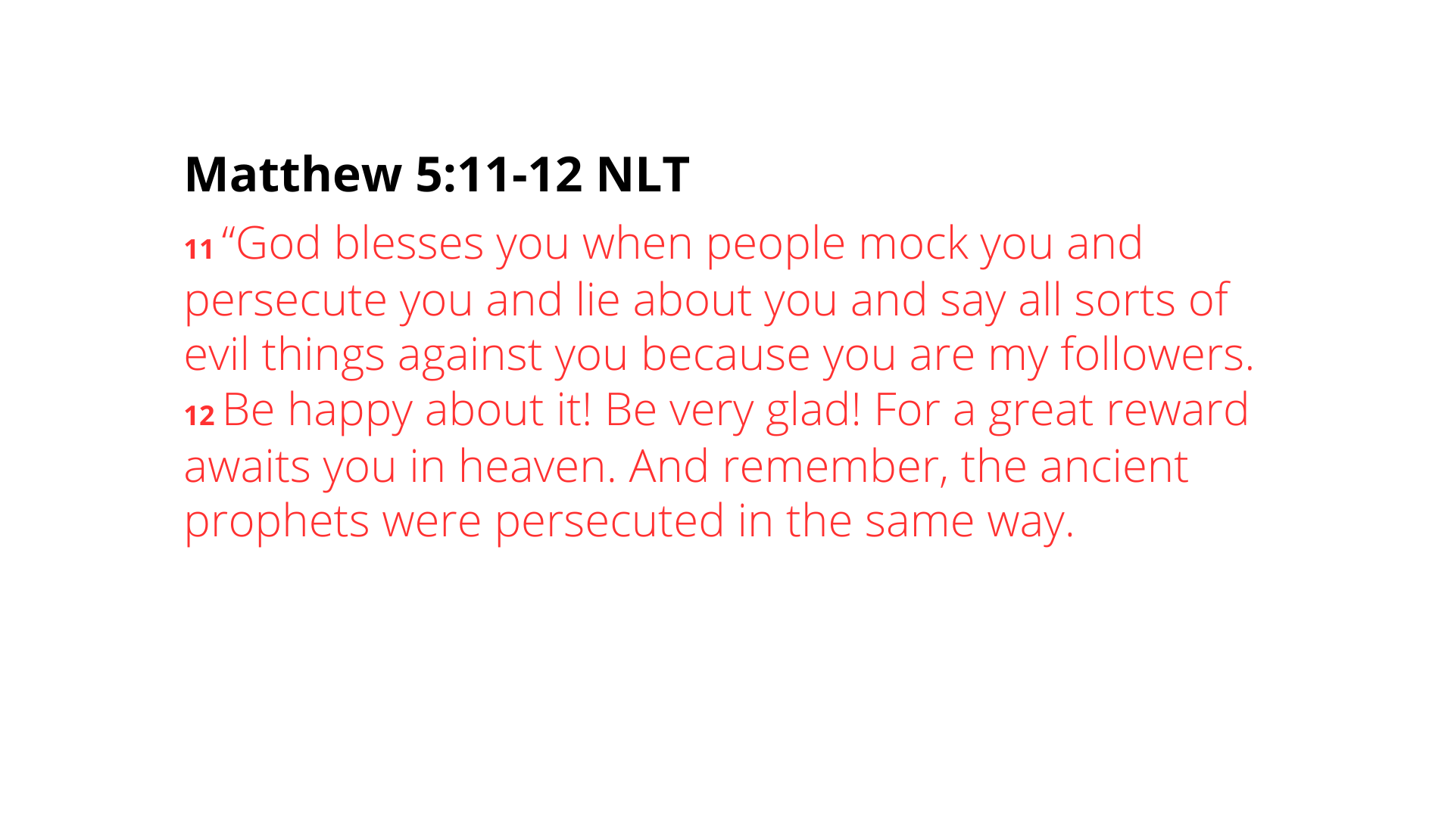
Notes:
[READ PASSAGE & COMMENT]
Again, from Jesus to the apostles, we are continually being invited to view our current life (including our trials and hardships) with the end in mind. Where are things going? And don’t you know that by yielding to the refining work of God in your life now—even through the pain and suffering of this world—you are storing up reward and treasures in heaven?
Brothers and sisters, in Matthew 19:29, Jesus said, “And everyone who has left houses or brothers or sisters or father or mother or wife or children or fields for my sake will receive a hundred times as much and will inherit eternal life.”
And listen to what Paul said in Romans 8, verse 18… [NEXT SLIDE]

Slide 8
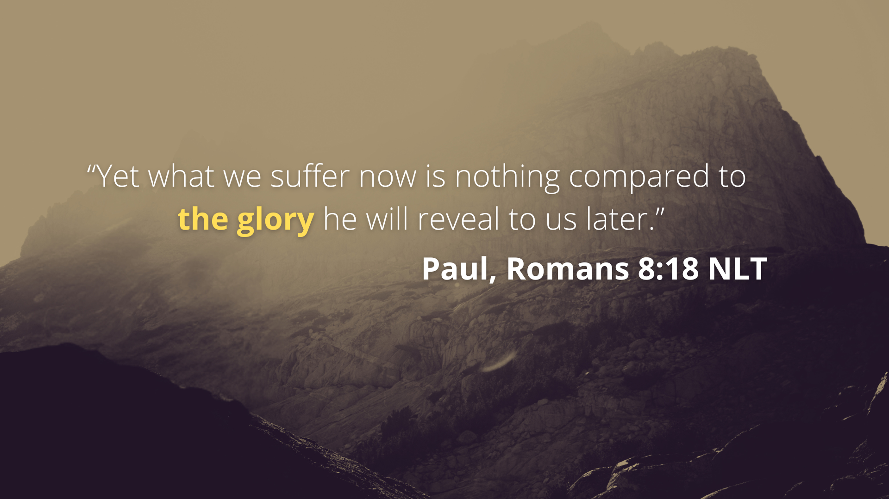
Notes:
[READ VERSE & COMMENT]
Again, what does Paul mean by “the glory” he will reveal to us later? He’s talking about things unspeakable, unimaginable, too great for you to fathom. We all know the expression, “It’s too good to be true.” Well, someday, if we will persevere, we will discover that all of our longings for it to be that good and that true will become a reality for us in heaven, and when heaven comes to earth.
Back to 1 Peter 4, verse 14… [NEXT SLIDE]

Slide 9
Notes:
v. 14 – Just remember, if someone uses their words as weapons against you because of your faith, then you are experiencing solidarity with Jesus. You reveal that you have on his team’s jersey. You reveal that you belong to him and that what happened to Jesus will happen to you someday, i.e., resurrection. He has you. You are his. And nothing can change that.
v. 15 – “meddler” in the Greek appears to be a word that Peter coined; he is describing someone who can’t mind their own business but also might involve someone having an air of moral superiority as they interact with others, especially unbelievers. In other words, if you’re suffering because you’re a self-righteous, hypocritical jerk, Peter is saying that suffering doesn’t count. You’re not suffering for Jesus, you’re suffering because you’re being an idiot. So, instead, if we’re going to suffer, we should suffer for living like Christ.
So, let’s consider for a moment what suffering for Christ might look where we live… [NEXT SLIDE]

Slide 10
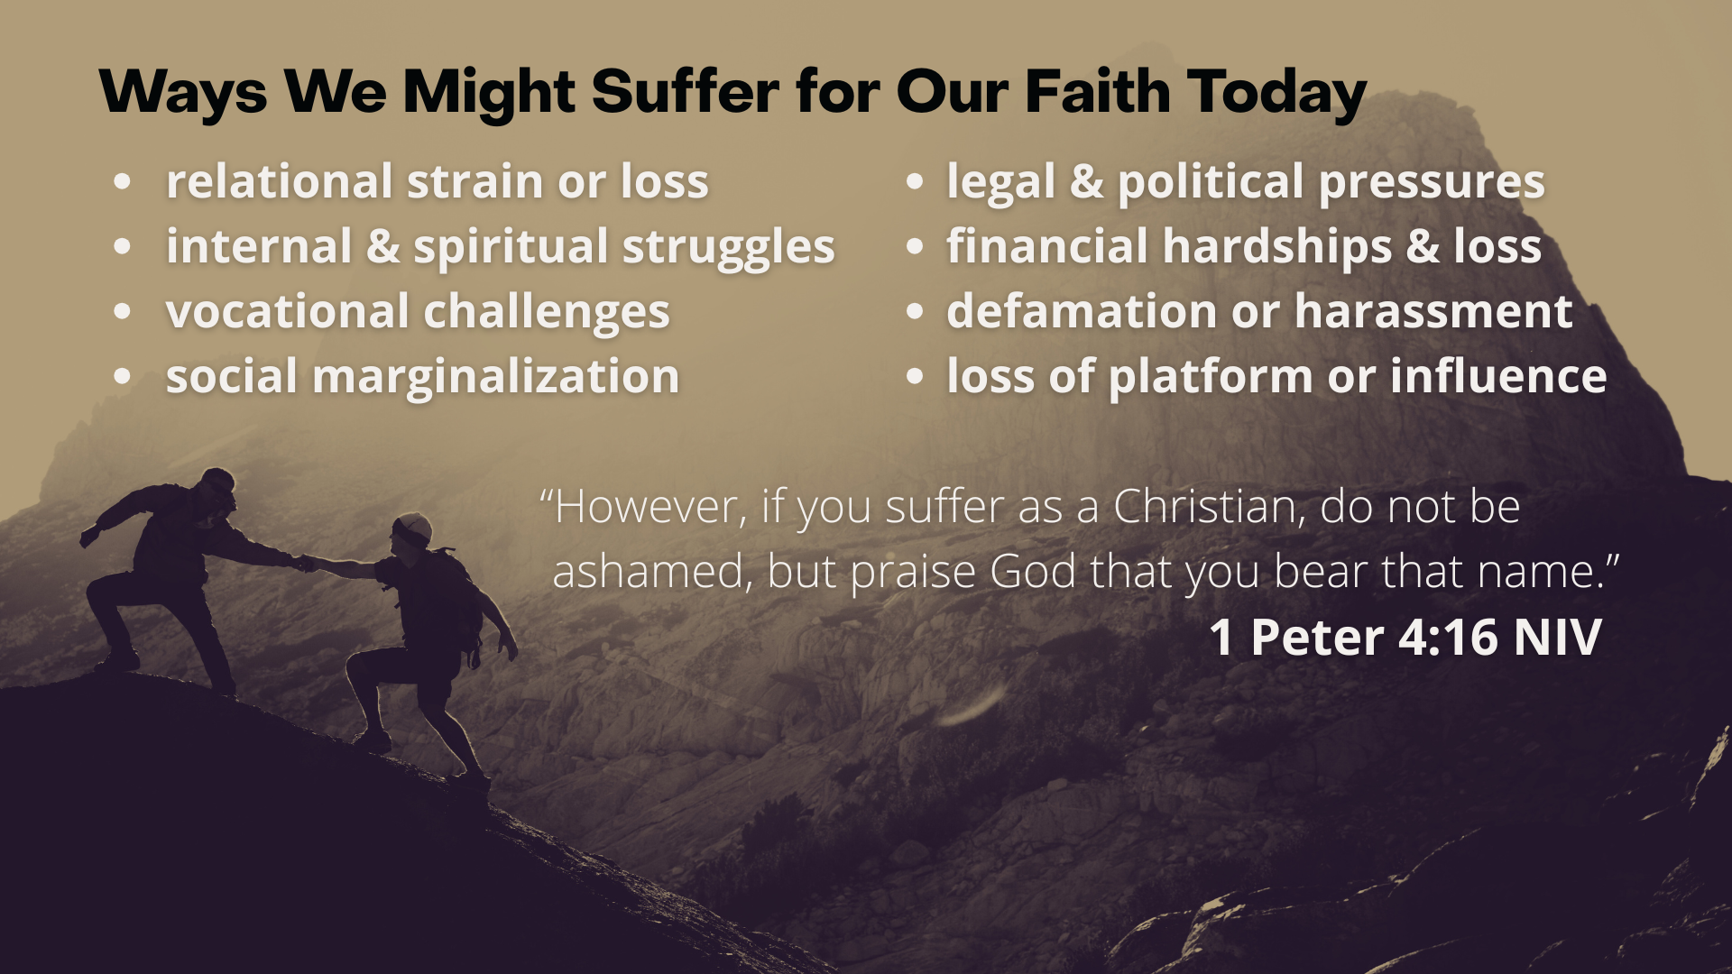
Notes:
relational strain or loss - tension or estrangement from family and friends who reject or ridicule your faith; maybe a loss of community or friendships because you’re choosing to follow Christ in ways that challenge cultural norms.
internal & spiritual struggles - feeling isolated or alone in your faith, especially in increasingly secular and idolatrous environments; maybe you’re wrestling with doubt, discouragement, or the temptation to compromise in order to fit in.
vocational challenges – you could be facing discrimination in the workplace for refusing to participate in unethical practices or policies that conflict with conscience; or pressure in schools to conform to secular ideologies and you’re being penalized for dissenting views.
social marginalization - being labeled intolerant, unloving, or “on the wrong side of history” when holding to biblical convictions about morality, sexuality, or truth; we see it in the misrepresentation of Christian beliefs in media, academia, or public discourse.
legal & political pressures – involving laws and regulations that may compel Christians to act against their conscience in areas such as healthcare, education, or business; also, legal battles over religious liberty, free speech, and public expression of faith.
financial hardships & loss – maybe because you refused to compromise your Christian convictions or because you simply put God’s calling on your life above making money
defamation or harassment - hostility at work or online harassment (possibly even abuse) when sharing your faith or speaking publicly about controversial issues.
loss of platform or influence – you might lose opportunities, a public platform or influence because of your faith and being open about your Christian convictions.
[READ VERSE 16] - Now the last two verses in chapter 4… [NEXT SLIDE]

Slide 11
Notes:
v. 17-18 – In other words, if suffering is being used to purify us and refine us as God’s people, Peter is saying that this is what God’s judgment for believer’s is all about. Yes, it’s about sifting the wheat from the chaff (the good deeds from the bad ones), but it’s also about making you like Christ and fit for an eternity in God’s presence. So, see your suffering for Christ as how God has already begun “judging you” or fashioning you for a life in glory. But woe to those whose suffering isn’t being used in that way. For their suffering is but the beginning of an eternal judgment that ends in death.
v. 19 – Let’s be clear: “according to God’s will” doesn’t mean that God wants us to suffer; I said that last week. But rather, it means that Christians suffer because they do God’s will. So, when suffering comes, trust in God (the creator’s) character, yield to this purifying process, and rejoice that you are becoming like Christ. Yes, rejoice, because your suffering is not for nothing.
Let’s sum up what we’ve read in 1 Peter 4:12-19 today. Here are some takeaways and application based on what we’ve covered in this message… [NEXT SLIDE]

Slide 12
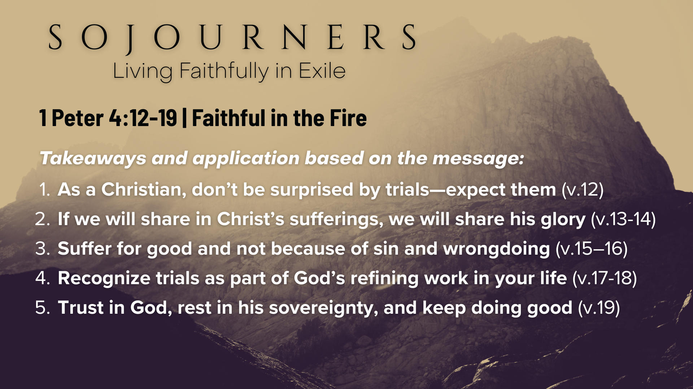
Notes:
As a Christian, don’t be surprised by trials—expect them (v.12) “Don’t be surprised—be prepared.” Trials are normal for God’s people; as followers of Jesus, we can expect them as part of discipleship.
If we will share in Christ’s sufferings, we will share his glory (v.13-14) “Rejoice in suffering—glory is coming.” Sharing in Christ’s pain now guarantees sharing in His glory later (Romans 8:18). Our troubles are momentary in light of eternity.
Suffer for good and not because of sin and wrongdoing (v.15–16) “Suffer for good, not for sin.” Make sure hostility comes because of faithfulness, not because of foolishness. Life is hard enough, don’t make it harder by doing stupid things.
Recognize trials as part of God’s refining work in your life (v.17-18) “God purifies before he glorifies.” Our trials are not punishment. Suffering comes to the faithful. And so, when it does, allow God to use it for your transformation. James 1:2-4 says, “Consider it pure joy, my brothers and sisters, whenever you face trials of many kinds, because you know that the testing of your faith produces perseverance. Let perseverance finish its work so that you may be mature and complete, not lacking anything.”
Trust in God, rest in his sovereignty, and keep doing good (v.19) “Keep doing good—God is faithful.” We endure suffering not by gritting our teeth or cursing God under our breath, but by trusting in his loving character, his power over all things, and his promise to bring good out of evil (Romans 8:28).
Finally, here are some questions to help us reflect and respond together… [NEXT SLIDE]

Slide 13
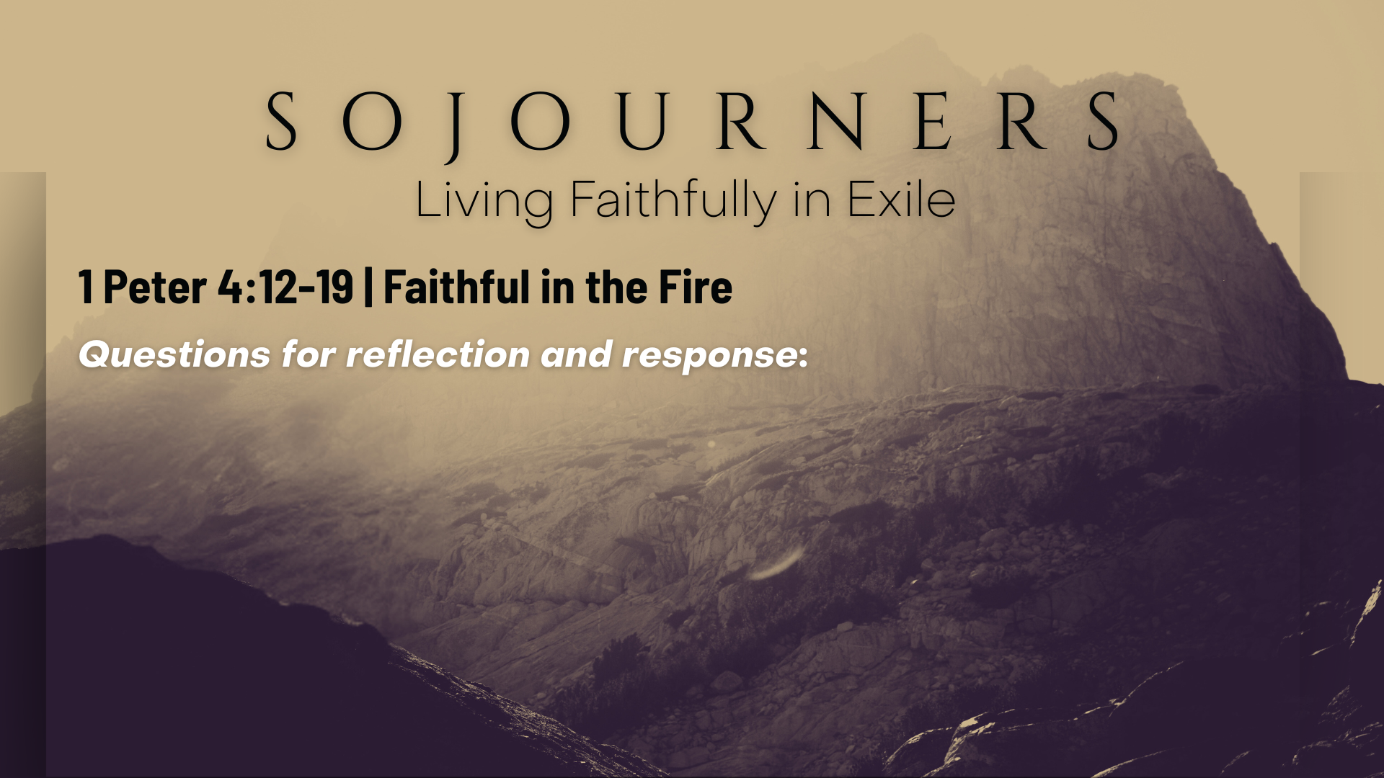

Slide 14
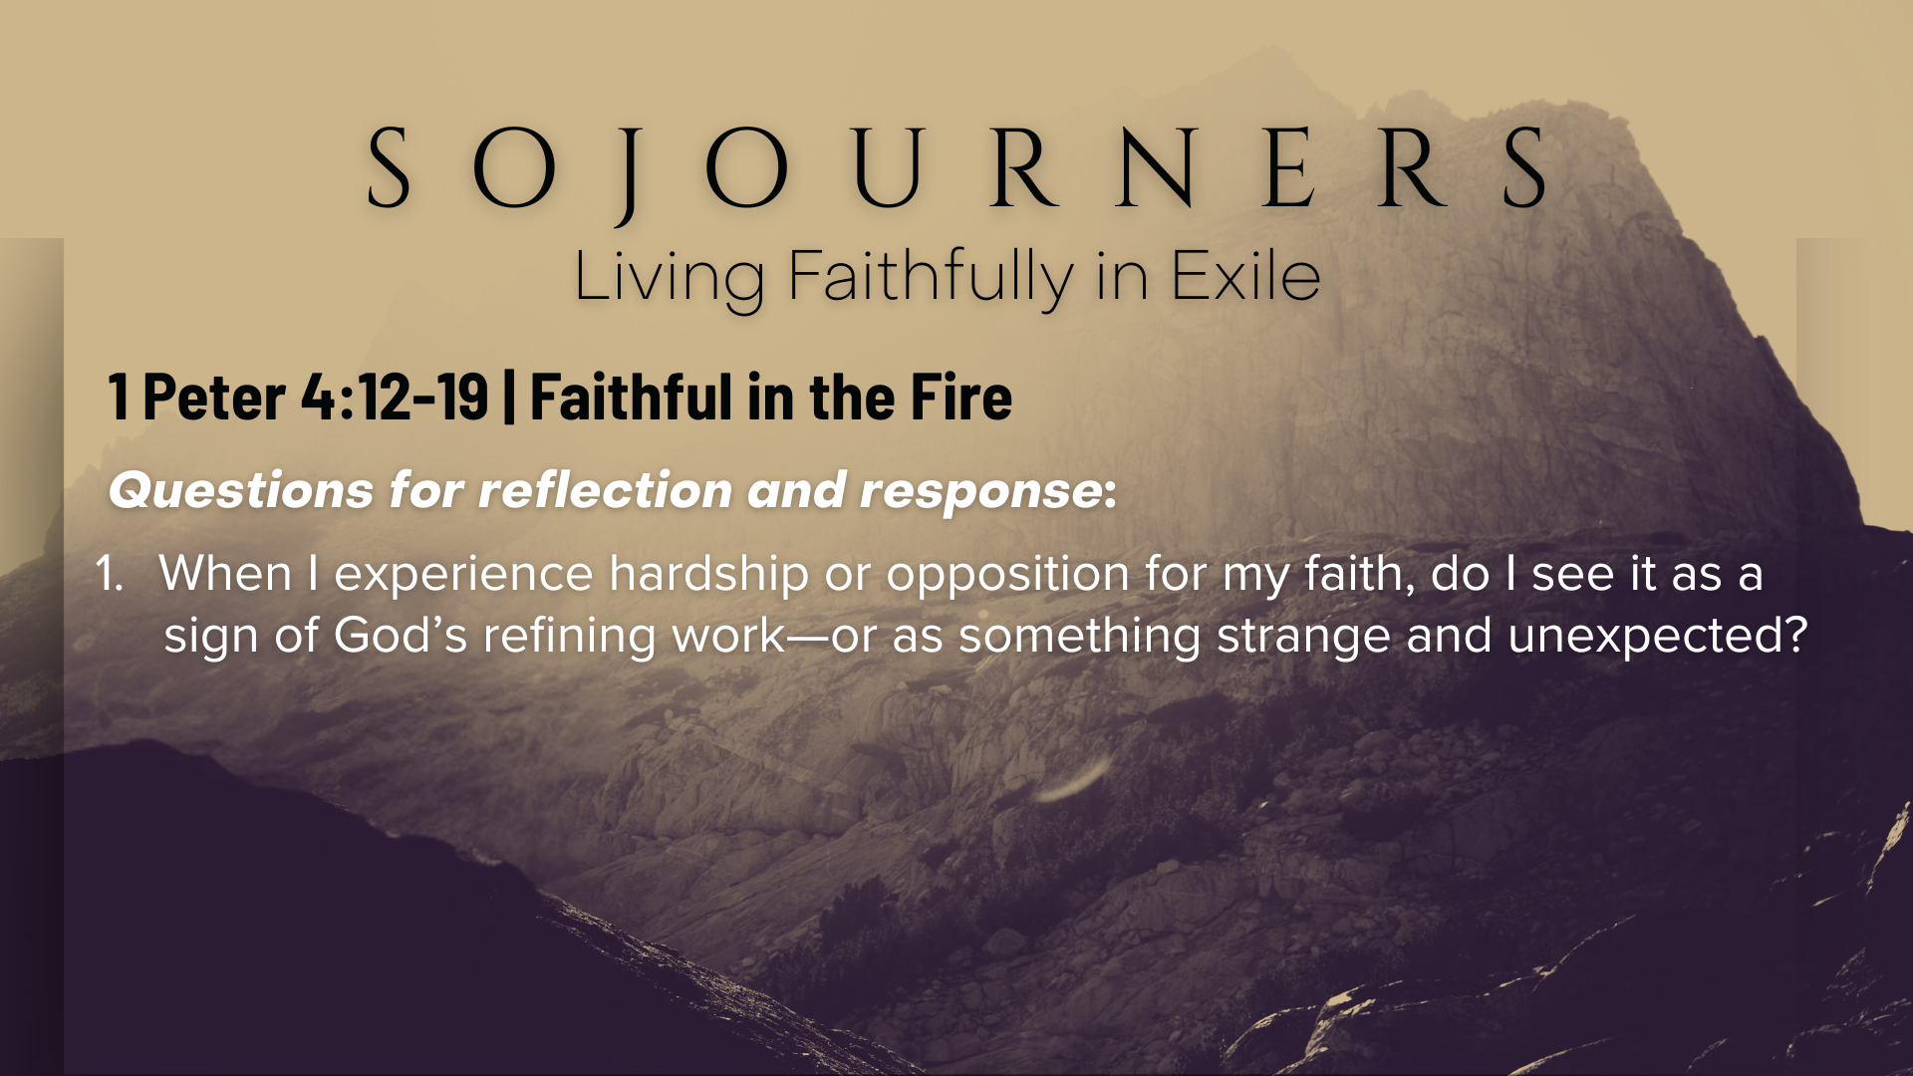

Slide 15
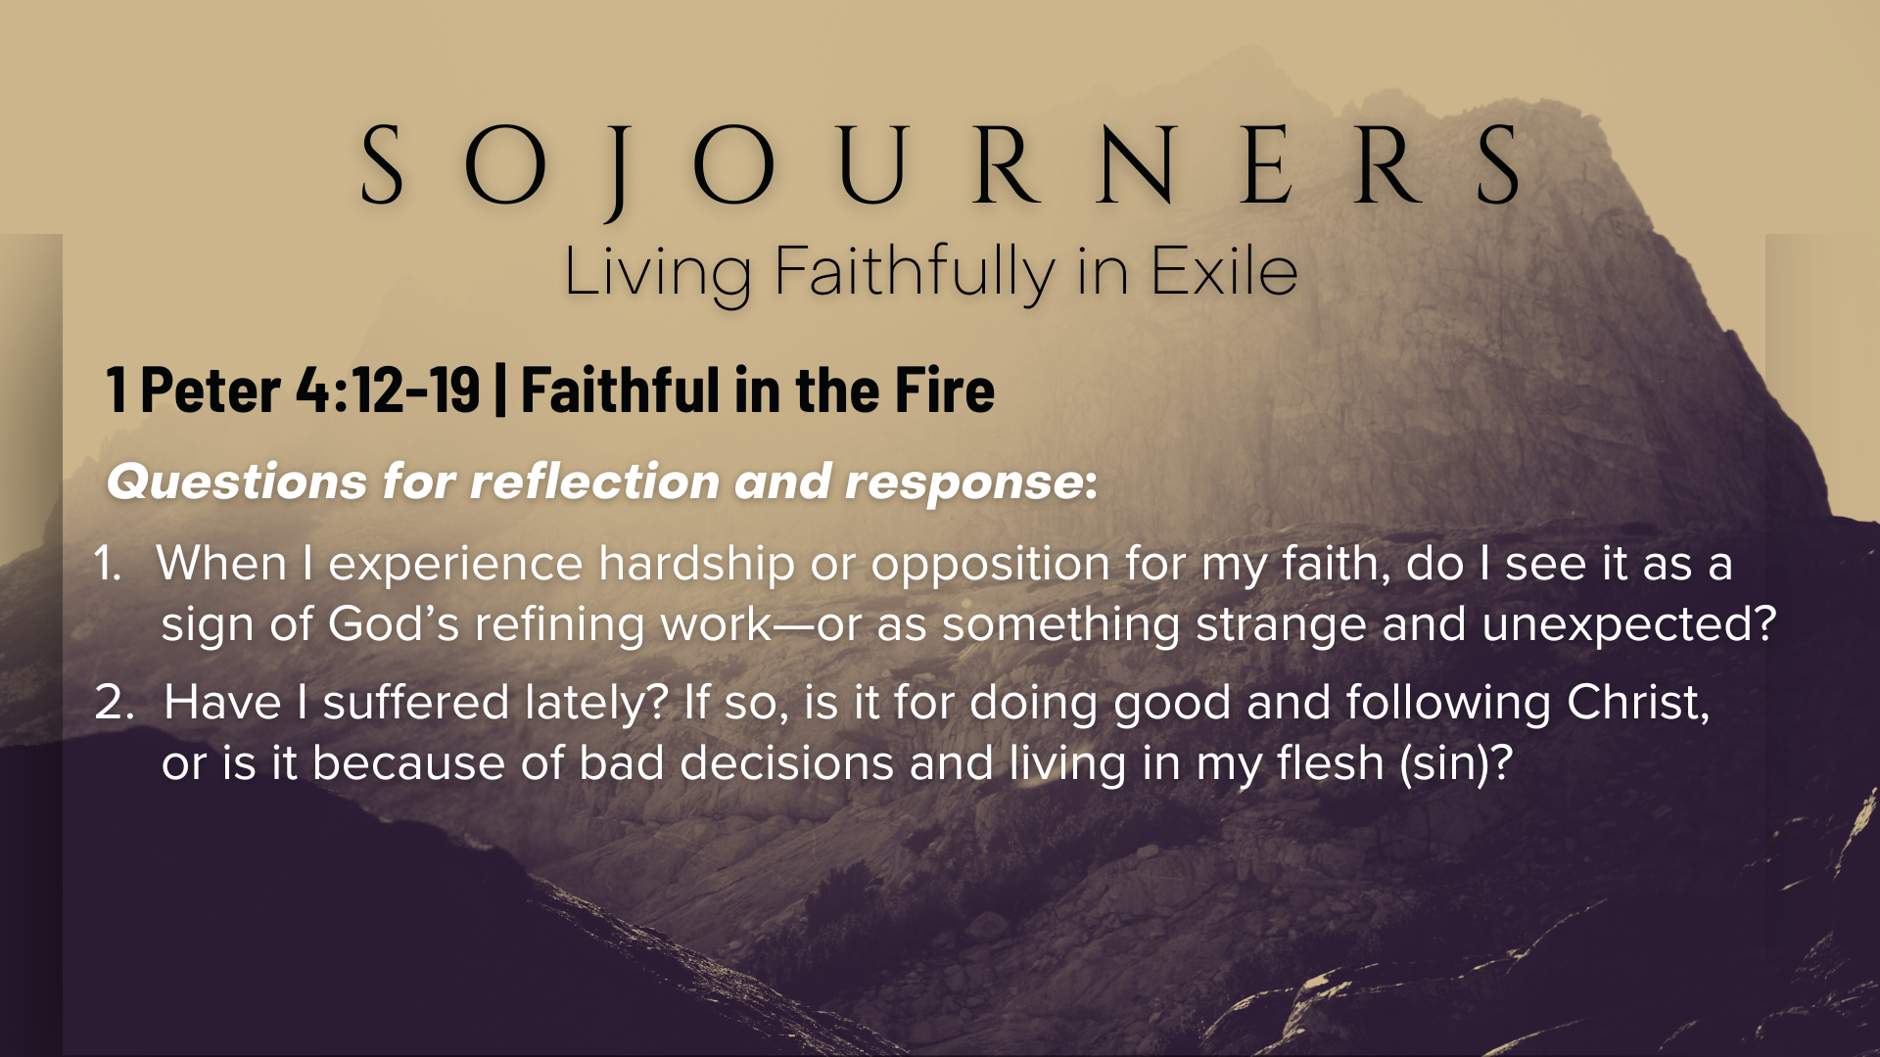

Slide 16
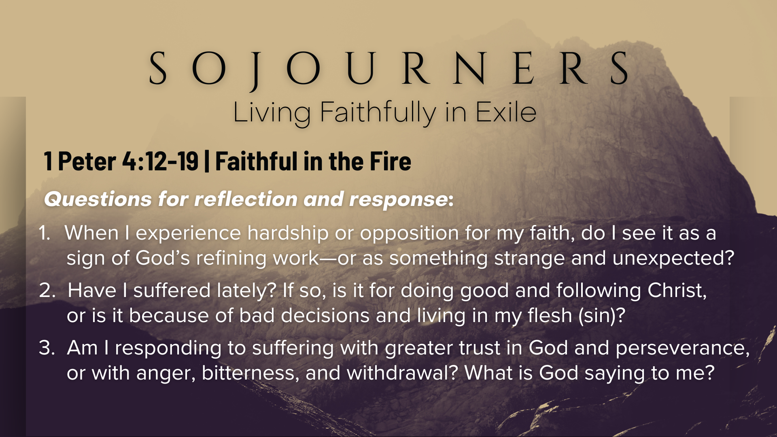
Notes:
[READ & BRIEF COMMENT ON EACH QUESTION]
When I experience hardship or opposition for my faith, do I see it as a sign of God’s refining work—or as something strange and unexpected?
Have I suffered lately? If so, is it for doing good and following Christ, or is it because of bad decisions and living in my flesh (sin)?
Am I responding to suffering with greater trust in God and perseverance, or with anger, bitterness, and withdrawal? What is God saying to me?
[CLOSING WORDS]
Let’s pray… [NEXT SLIDE FOR CLOSING PRAYER]

Slide 17
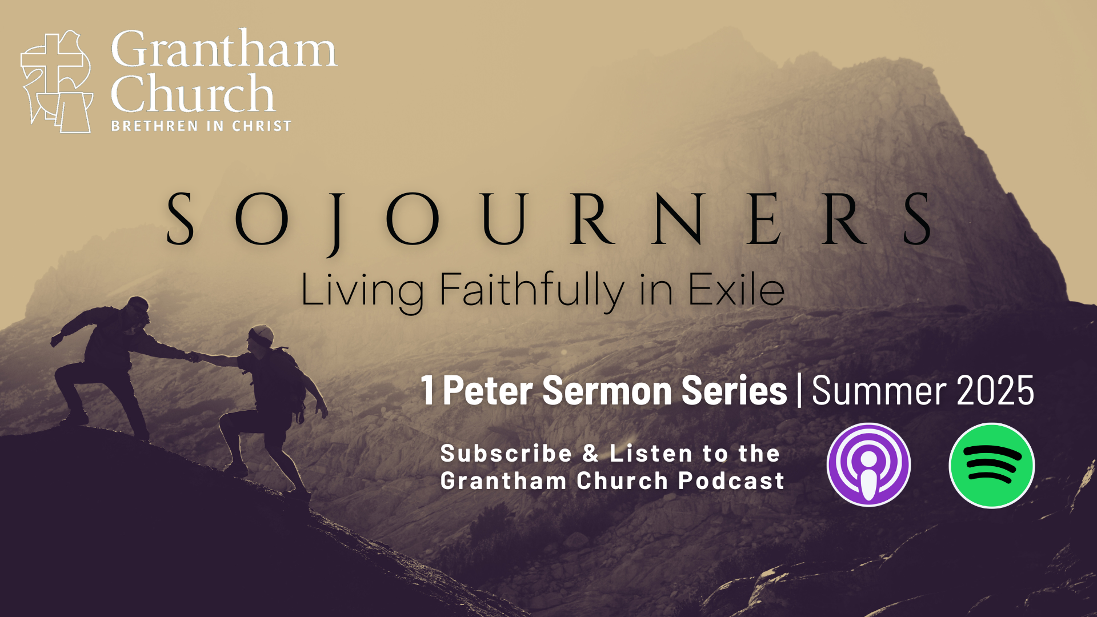
Notes:
[CLOSING PRAYER]
Benediction
Chosen people of God, as sojourners and exiles in this world,
set your hearts on the Living Hope – Christ risen and reigning.
As you go into the world,
may you walk in hope,
stand firm in God’s grace,
shine with the love of Jesus,
and allow the Spirit to sustain you in all things,
until the day your sojourning gives way to glory.
Go in peace, church,
and live faithfully in exile.
Amen.

